Slide 1
Causal Inference for Policy Evaluation
Susan Athey, Stanford GSB
Based on joint work with Guido Imbens, Stefan Wager

Slide 2
References outside CS literature
Imbens and Rubin Causal Inference book (2015): synthesis of literature prior to big data/ML
Tutorial slides from ICML 2016: http://www.cs.nyu.edu/~shalit/slides.pdf
  Note: Unconfoundedness is only one setting for analyzing causal inference in observational studies
My articles on http://arxiv.org
Kleinberg, Ludwig, Mullainathan, Obermeyer (2015): Prediction policy problems

Slide 3
Causal Inference in Social Sciences
What was the impact of the policy?
  Minimum wage, training program, class size change, etc.
Did the advertising campaign work? What was the ROI?
Do get-out-the vote campaigns work?
What would happen to prices, consumption, consumer welfare, and firm profits if two firms merge?
What would happen to platform revenue, advertiser profits and consumer welfare if we switch from a generalized second price auction to a Vickrey auction?

Slide 4
Correlation vs. Causality in Search

Slide 5
Conventions and Approaches
Come up with a way to separate correlation from causality (deal with confounders)
  Randomized experiment
  “Natural experiments”
  Assume that agents respond optimally to confounders, and infer them
Estimate a model
  NOT the best in-sample fit
  Focus on estimation of treatment effect parameters or predictions about the impact of a treatment
Table stakes: statistical significance (p-values)

Slide 6
Key Differences vs. Supervised Learning
Train-Test Paradigm breaks
  Ground truth is not observed for your ultimate goal
  Sometimes it can be estimated or learned in a randomized experiment
Objective functions are different
  Not concerned about predicting outcomes, want effect of an intervention
  Sacrifice MSE of outcome predictions
Statistical properties often table stakes
  Need statistical theory in the absence of assumption-free MSE on test set approach
  Sacrifice MSE of outcome predictions
Role of statistical assumptions and modeling

Slide 7
Key Connections with Supervised ML
Prediction is key component of causal inference
Causal inference in big data settings benefits from flexible model selection
Problems of causal inference are prevalent in settings where ML is used
  What is the effect of the position of an ad or an algorithmic link in search?
  How many clicks would an ad receive if it were placed in the first position?
  Personalized recommendations or policies
Statistical issues have analogs in ML
  Partial labels/missing data
  Domain adaptation
Causal models are designed to learn fundamental relationships that hold across environments.
  They may be more robust and reliable, especially in complex systems
  Embedded ML (ACM 2015)
  Reliable ML Workshop (ICML 2016)
  Interpretable ML Workshop (ICML 2016)

Slide 8
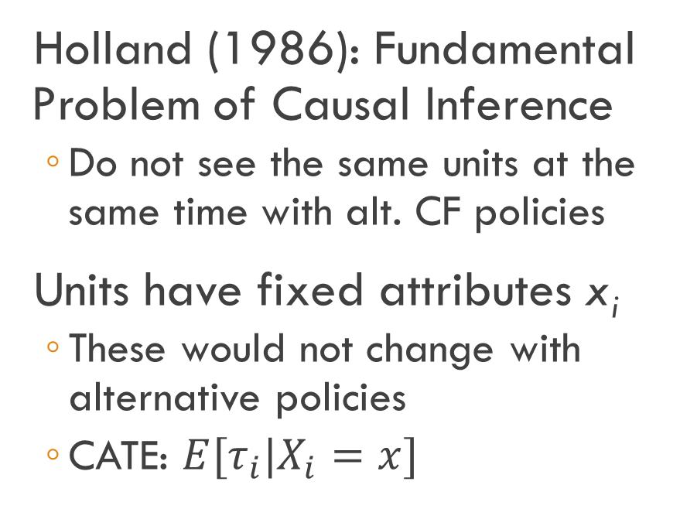
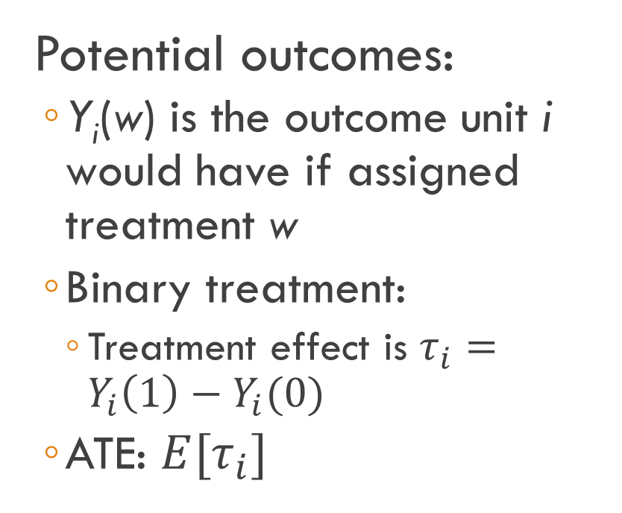
Model for Causal Inference
Potential outcomes:
  Y_{i}(w) is the outcome unit i would have if assigned treatment w
  Binary treatment:
    Treatment effect is $τ_{i}=Y_{i}\left(1\right)−Y_{i}(0)$
  ATE: $E[τ_{i}]$
Holland (1986): Fundamental Problem of Causal Inference
  Do not see the same units at the same time with alt. CF policies
Units have fixed attributes x_{i}
  These would not change with alternative policies
  CATE: $E[τ_{i}|X_{i}=x]$
Note: a change in policy changes the joint distribution of observables!!!

Slide 9
Randomized Experiments
Gold standard for causal inference
Two samples; treatment assignment independent of potential outcomes
  With enough data, straightforward to estimate the effect of treatment
  Still don’t DIRECTLY observe ground truth for a given observation
Goals
  Average treatment effects
  Conditional average treatment effects
  Optimal policies
  Determine whether results are spurious (sampling variation) – p-value

Slide 10
Experimental Settings
Reducing variance for average treatment effect estimation
Estimating heterogeneous treatment effects and optimal treatment policies
Individuals may be very different
  Large v. small advertisers in search
  Heavy v. light users
Groups may be imbalanced due to sampling variation
Athey and Imbens (2016) suggest:
  If possible, stratify by design
  If not, stratify analysis
  Partition the covariate space (e.g., regression trees)
Discover partition (subgroups) and test hypotheses about treatment effects
Nonparametric models of heterogeneous treatment effects
Optimal (personalized) policies

Slide 11
Observational Studies
Estimating average treatment effects under unconfoundedness
Instrumental variables
Analyst has access to information about factors that “confound” treatment assignment and outcomes
  E.g. link quality confounds position and clicks
  Higher ability people go to college
  Firms raise price when valuations rise
Massive literature in small data case
  Very recently, lots of interest in bringing supervised ML to big data case
Find variables that shift treatment assignment but do not confound outcomes
Use only variation in treatment assignment that is explained by instrument
Sacrifice goodness of fit for causal inference
Other popular approaches: Difference in differences; synthetic control groups; regression discontinuity; simultaneous eqns

Slide 12
Structural Models
Answering these questions requires:
  Agent preferences
    Inferred using revealed preference and assumption that agents in data were maximizing
  Behavioral/equilibrium model for counterfactual world
Applications use structural equations approach
  More complicated than potential outcomes notation
  Typically model latent variables directly
Treatments never seen before
  What would happen if two firms merged?
  What would happen if Google switched from Generalized Second Price Auction to Vickrey Auction?
  Changes to ACA health exchanges?
Welfare calculations
  How would a change affect user utility, firm profits, and social welfare?
Applications in auctions: see Athey and Haile (2002), Athey, Levin, and Seira (2011), Athey, Coey, and Levin (2013), Athey and Nekipelov (2012)

Slide 13
Estimating Heterogeneous Treatment Effects
Building on strength of supervised ML methods for personalized treatment effect estimates

Slide 14
Experiments and Data-Mining
Concerns about ex-post “data-mining” for heterogeneous treatment effects
  In medicine, scholars required to pre-specify analysis plan
Hard to predict all forms of heterogeneity with many covariates
Goal:
  Allow researcher to specify set of potential covariates
  Data-driven search for heterogeneity in causal effects with valid standard errors
  In settings with many covariates relative to observations (“wide”)
Standard errors are table stakes

Slide 15
Research Agenda
How to re-optimize ML algorithms for goal of causal estimation and inference rather than prediction
  New criterion functions, modified regularization approaches, greater reliance on statistical theory
  Recognize that focusing on goodness of fit for outcomes can be in conflict with good (unbiased, efficient) causal inference
  Closely related to contextual bandit literature in ML

Slide 16
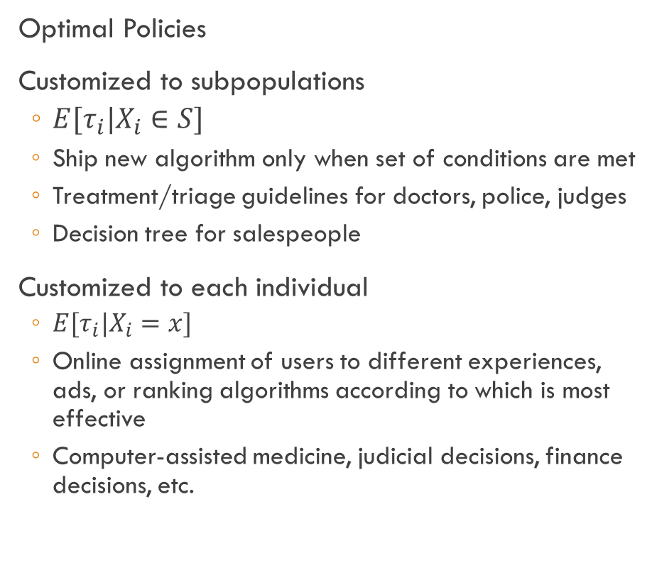
Heterogeneous Treatment Effects
Estimating the impact of a treatment
Applications
  A/B Tests
  Observational study of the impact of a system change or marketing campaign
  Effect of a drug
Goals
  Systematically identify subpopulations and estimate treatment effects, valid inference
  Understand mechanisms
  Gain insight for developing further improvements to the treatment
Optimal Policies
Customized to subpopulations
  $E[τ_{i}|X_{i}∈S]$
  Ship new algorithm only when set of conditions are met
  Treatment/triage guidelines for doctors, police, judges
  Decision tree for salespeople
Customized to each individual
  $E[τ_{i}|X_{i}=x]$
  Online assignment of users to different experiences, ads, or ranking algorithms according to which is most effective
  Computer-assisted medicine, judicial decisions, finance decisions, etc.

Slide 17
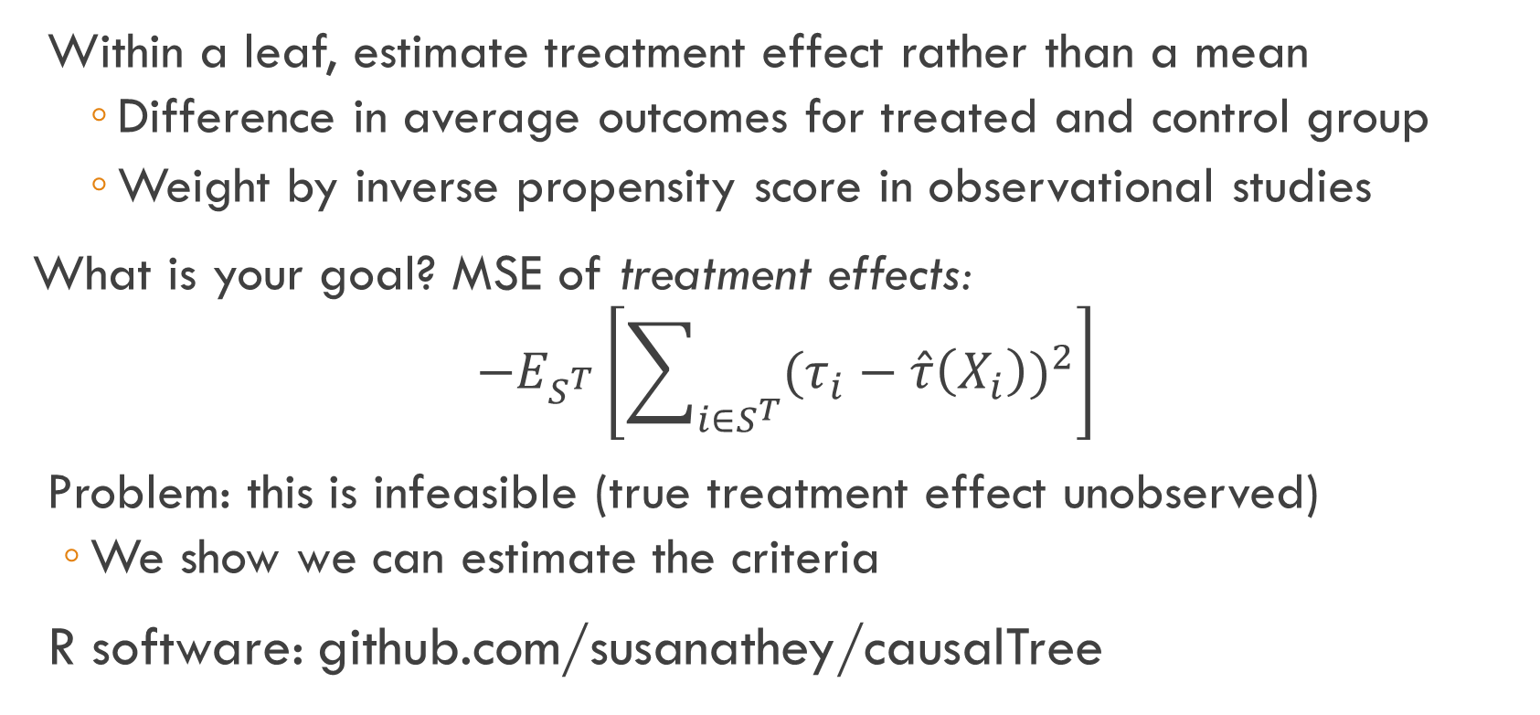
Causal Trees: CART for Causal Inference
Within a leaf, estimate treatment effect rather than a mean
    Difference in average outcomes for treated and control group
    Weight by inverse propensity score in observational studies
What is your goal? MSE of treatment effects:
$$−E_{S^{T}}\left[\sum_{i∈S^{T}}{{(τ_{i}−\hat{τ}\left(X_{i}\right))}^{2}}\right]$$
Problem: this is infeasible (true treatment effect unobserved)
  We show we can estimate the criteria
R software: github.com/susanathey/causalTree
Notes:
Causal trees: estimate average treatment effect within leaves as difference in average outcomes by treatment status (more efficient than average of transformed outcome)
would like to minimize sum(tau_i-hat_tau_i)^2, but not feasible, replace this infeasible target by unbiased estimate

Slide 18
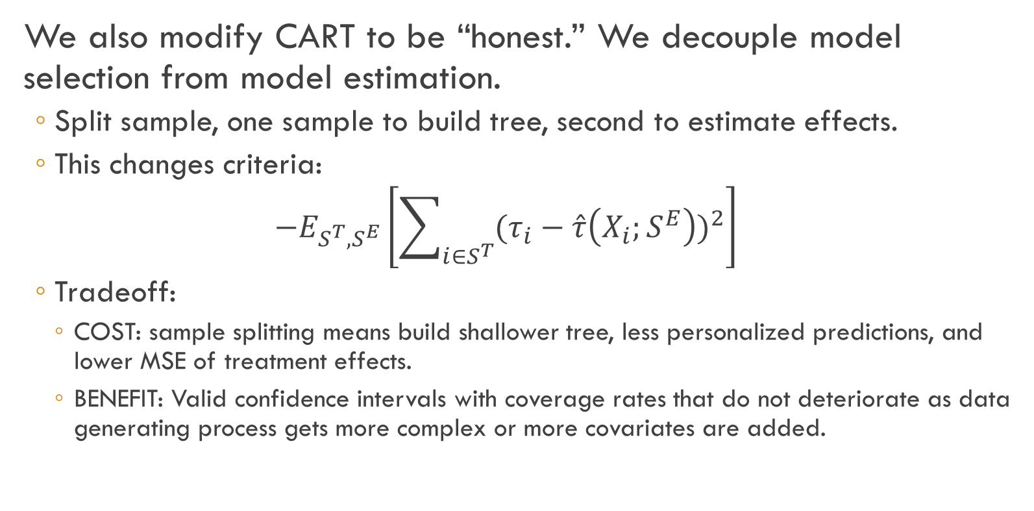
Honest Causal Trees
We also modify CART to be “honest.” We decouple model selection from model estimation.
  Split sample, one sample to build tree, second to estimate effects.
  This changes criteria:
  $$−E_{S^{T},S^{E}}\left[\sum_{i∈S^{T}}{{(τ_{i}−\hat{τ}\left(X_{i};S^{E}\right))}^{2}}\right]$$
  Tradeoff:
    COST: sample splitting means build shallower tree, less personalized predictions, and lower MSE of treatment effects.
    BENEFIT: Valid confidence intervals with coverage rates that do not deteriorate as data generating process gets more complex or more covariates are added.
Notes:
Causal trees: estimate average treatment effect within leaves as difference in average outcomes by treatment status (more efficient than average of transformed outcome)
would like to minimize sum(tau_i-hat_tau_i)^2, but not feasible, replace this infeasible target by unbiased estimate

Slide 19
Honest Causal Trees
Honest estimation changes expected criterion
  Criterion anticipates that we will re-estimate effects in the leaves.
    The bias due to “dishonest” selection of tree structure will be eliminated.
    Eliminating the bias was the main purpose of cross-validation in standard method.
  We face uncertainty in what honest sample will estimate
    Small leaves will create noise.
    Splitting on variables that don’t affect treatment effect can reduce variance
Criterion for splitting and cross-validation changes
  Given set of leaves, MSE on test set taking into account re-estimation.
  Uncertainty over estimation set and test set at time of evaluation.
Notes:
Causal trees: estimate average treatment effect within leaves as difference in average outcomes by treatment status (more efficient than average of transformed outcome)
would like to minimize sum(tau_i-hat_tau_i)^2, but not feasible, replace this infeasible target by unbiased estimate

Slide 20
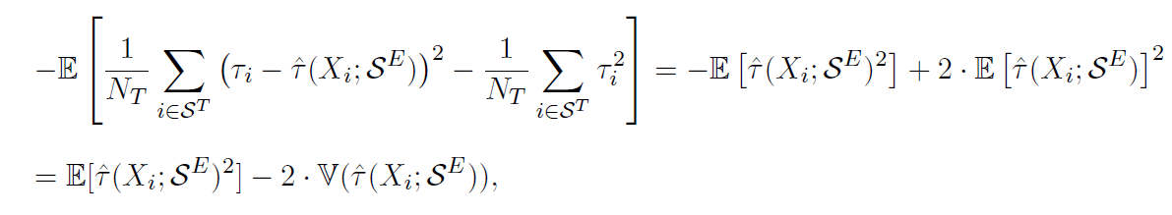
Honest Causal Trees
Criterion for splitting and cross-validation changes
  Given set of leaves, MSE on test set taking into account re-estimation.
  Uncertainty over estimation set and test set at time of evaluation.
This uses fact that estimator on independent sample is unbiased
Notes:
Causal trees: estimate average treatment effect within leaves as difference in average outcomes by treatment status (more efficient than average of transformed outcome)
would like to minimize sum(tau_i-hat_tau_i)^2, but not feasible, replace this infeasible target by unbiased estimate

Slide 21
Inference
Attractive feature of trees:
  Can separate tree construction from treatment effect estimation
  Tree constructed on training sample is indep. of test sample
  Holding tree from training sample fixed, can use standard methods to conduct inference within each leaf of the tree on test sample
We do not require ANY assumptions about sparsity of true data-generating process.
  Coverage does NOT deteriorate at all as you increase number of covariates
  We do not attempt to make fully personalized estimates

Slide 22
Comparing Alternative Approaches to Honest Causal Tree
Non-honest with double the sample
  Does worse if true model is sparse (also the case where bias is less severe)
  Has similar or better MSE in many cases, but poor coverage of confidence intervals
Splitting on statistical criteria of model fit
  Splitting on T-statistic on treatment effect ignores variance reduction from reducing imbalance on covariates
  Splitting on overall model fit prioritizes level heterogeneity above treatment effects

Slide 23
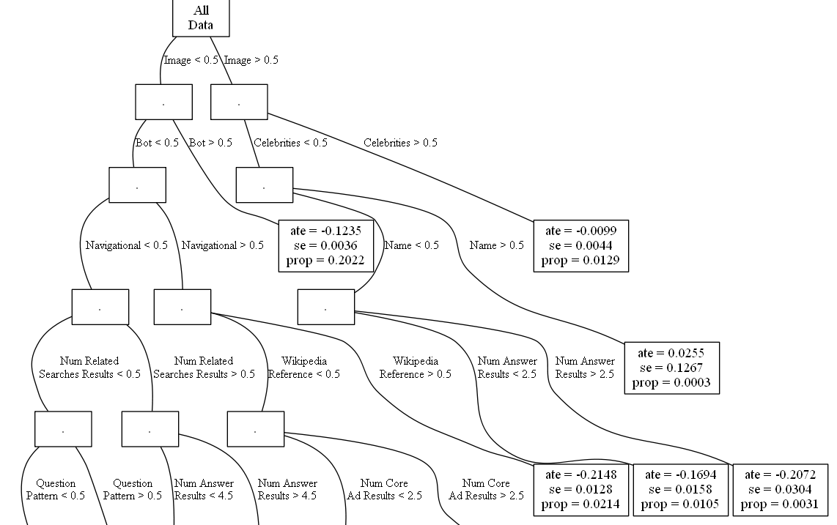
Search Experiment Tree: Effect of Demoting Top Link (Test Sample Effects)
Some data excluded with prob p(x): proportions do not match population
Highly navigational queries excluded

Slide 24
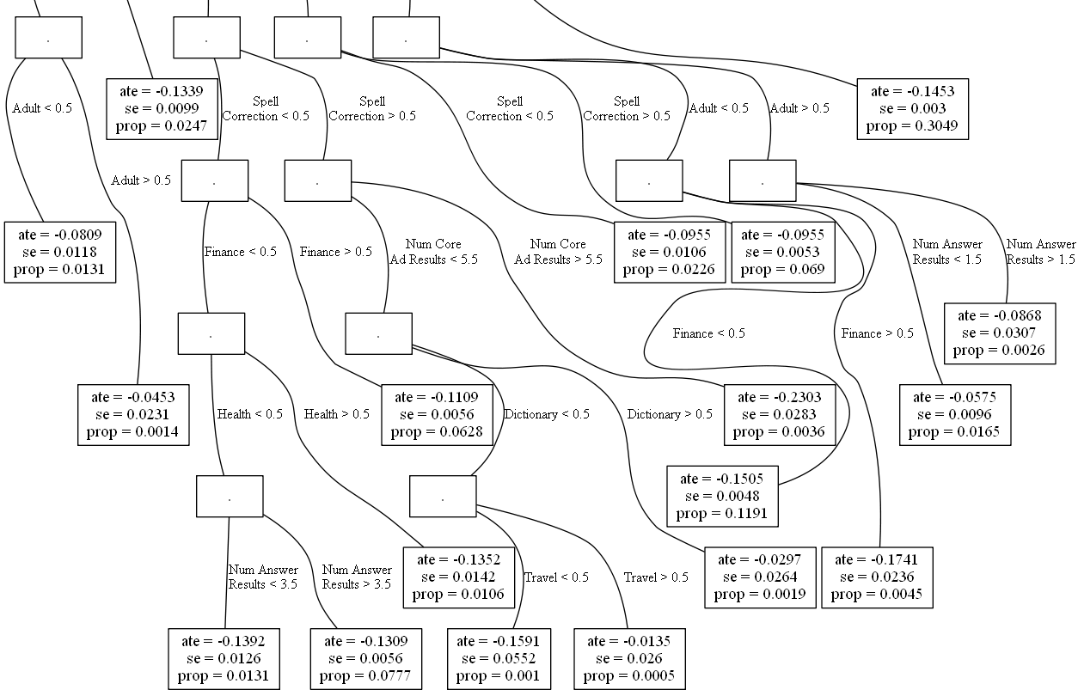

Slide 25
Use Estimation Sample for Segment Means & Std Errors to Avoid Bias
Variance of estimated treatment effects in training sample 2.5 times that in test sample (adaptive estimates biased)
Honest Estimates |  |  | Adaptive Estimates
Treatment Effect | Standard Error | Proportion | Treatment Effect | Standard Error | Proportion
-0.124 | 0.004 | 0.202 | -0.124 | 0.004 | 0.202
-0.134 | 0.010 | 0.025 | -0.135 | 0.010 | 0.024
-0.010 | 0.004 | 0.013 | -0.007 | 0.004 | 0.013
-0.215 | 0.013 | 0.021 | -0.247 | 0.013 | 0.022
-0.145 | 0.003 | 0.305 | -0.148 | 0.003 | 0.304
-0.111 | 0.006 | 0.063 | -0.110 | 0.006 | 0.064
-0.230 | 0.028 | 0.004 | -0.268 | 0.028 | 0.004
-0.058 | 0.010 | 0.017 | -0.032 | 0.010 | 0.017
-0.087 | 0.031 | 0.003 | -0.056 | 0.029 | 0.003
-0.151 | 0.005 | 0.119 | -0.169 | 0.005 | 0.119
-0.174 | 0.024 | 0.005 | -0.168 | 0.024 | 0.005
0.026 | 0.127 | 0.000 | 0.286 | 0.124 | 0.000
-0.030 | 0.026 | 0.002 | -0.009 | 0.025 | 0.002
-0.135 | 0.014 | 0.011 | -0.114 | 0.015 | 0.010
-0.159 | 0.055 | 0.001 | -0.143 | 0.053 | 0.001
-0.014 | 0.026 | 0.001 | 0.008 | 0.050 | 0.000
-0.081 | 0.012 | 0.013 | -0.050 | 0.012 | 0.013
-0.045 | 0.023 | 0.001 | -0.045 | 0.021 | 0.001
-0.169 | 0.016 | 0.011 | -0.200 | 0.016 | 0.011
-0.207 | 0.030 | 0.003 | -0.279 | 0.031 | 0.003
-0.096 | 0.011 | 0.023 | -0.083 | 0.011 | 0.022
-0.096 | 0.005 | 0.069 | -0.096 | 0.005 | 0.070
-0.139 | 0.013 | 0.013 | -0.159 | 0.013 | 0.013
-0.131 | 0.006 | 0.078 | -0.128 | 0.006 | 0.078

Slide 26
From Trees to Random Forests

Slide 27
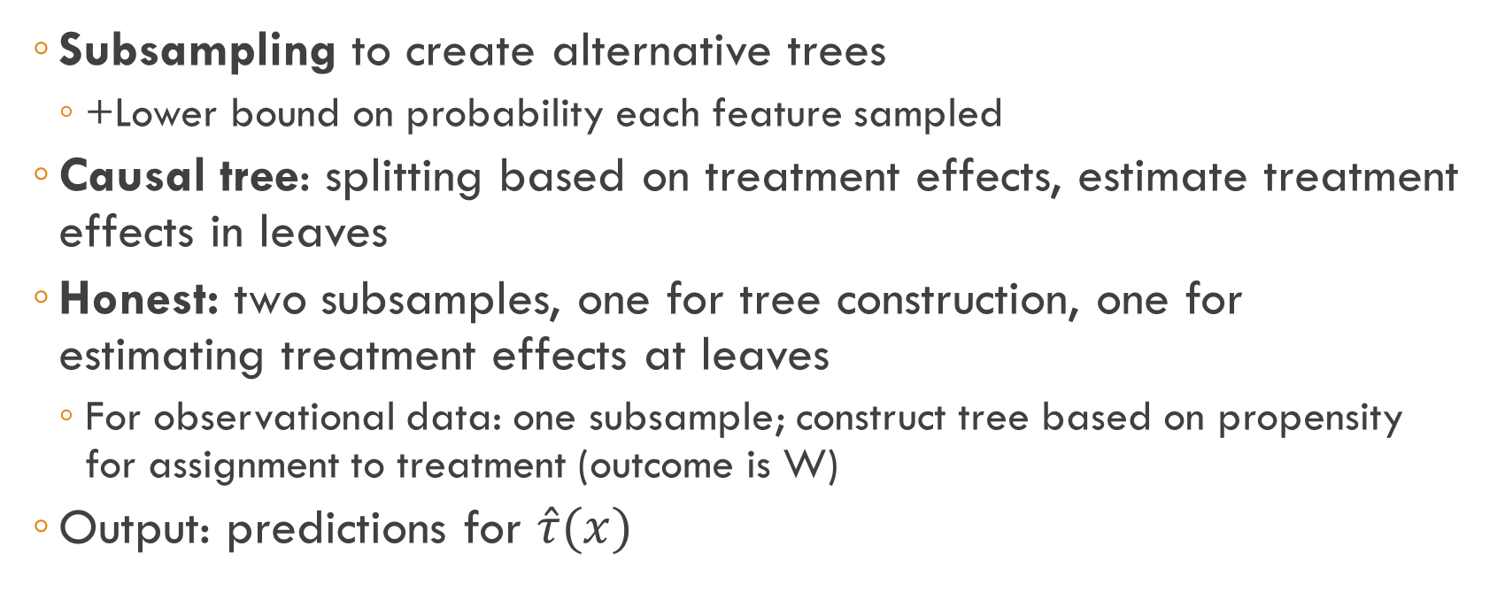
Causal Forests
  Subsampling to create alternative trees
    +Lower bound on probability each feature sampled
  Causal tree: splitting based on treatment effects, estimate treatment effects in leaves
  Honest: two subsamples, one for tree construction, one for estimating treatment effects at leaves
    For observational data: one subsample; construct tree based on propensity for assignment to treatment (outcome is W)
  Output: predictions for $\hat{τ}(x)$

Slide 33
General Social Survey:
Strong Heterogeneity

Slide 34
Estimating ATE under Unconfoundedness
Solving correlation v. causality by controlling for confounders

Slide 35
Idea
Only observational data is available
Analyst has access to data that is sufficient for the part of the information used to assign units to treatments that is related to potential outcomes
Analyst doesn’t know exact assignment rule and there was some randomness in assignment
Conditional on observables, we have random assignment
Lots of small randomized experiments

Slide 36
Example: Effect of an Online Ad
Ads are targeted using cookies
User sees car ads because advertiser knows that user visited car review websites
Cannot simply relate purchases for users who saw an ad and those who did not:
  Interest in cars is unobserved confounder
Analyst can see the history of websites visited by user
  This is the main source of information for advertiser about user interests

Slide 37
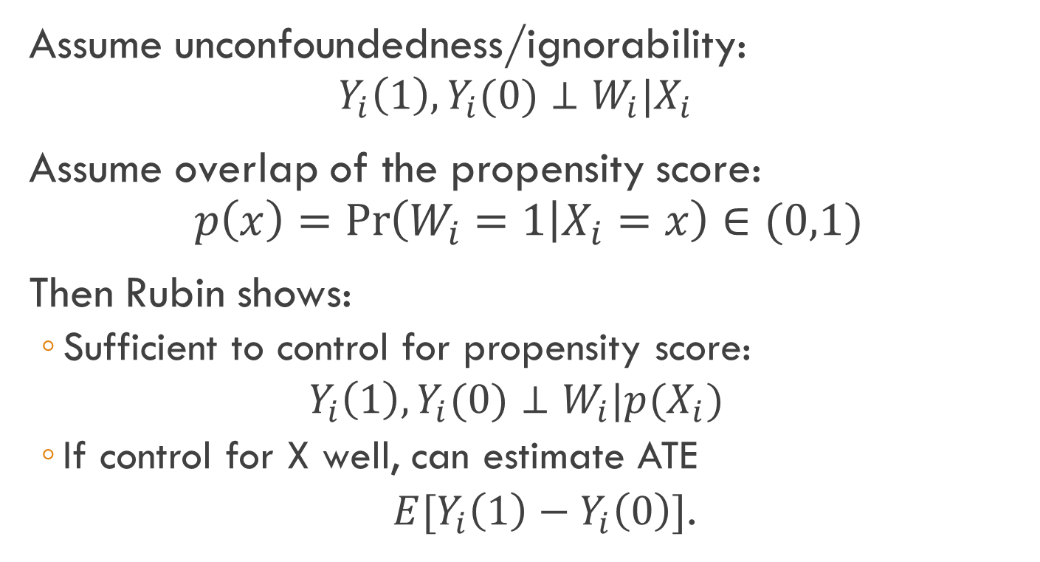
Setup
Assume unconfoundedness/ignorability:
  $$Y_{i}\left(1\right),Y_{i}(0)⊥W_{i}|X_{i}$$
Assume overlap of the propensity score:
$$p\left(x\right)=Pr\left(W_{i}=1 | X_{i}=x\right)∈(0,1)$$
Then Rubin shows:
  Sufficient to control for propensity score:
  $$Y_{i}\left(1\right),Y_{i}(0)⊥W_{i}|{p(X}_{i})$$
  If control for X well, can estimate ATE
  $E[Y_{i}\left(1\right)−Y_{i}\left(0\right)]$.

Slide 38
Intuition for Most Popular Methods
Control group and treatment group are different in terms of observables
Need to predict cf outcomes for treatment group if they had not been treated
Weighting/Matching: Since assignment is random conditional on X, solve problem by reweighting control group to look like treatment group in terms of distribution of X
  P.S. weighting/matching: need to estimate p.s., cannot perfectly balance in high dimensions
Outcome models: Build a model of Y|X=x for the control group, and use the model to predict outcomes for x’s in treatment group
  If your model is wrong, you will predict incorrectly
Doubly robust: methods that work if either p.s. model OR model Y|X=x is correct

Slide 39
Using Supervised ML to Estimate ATE Under Unconfoundedness
Method I: Propensity score weighting or KNN on p.s.
  LASSO to estimate p.s.; e.g. Hill, Weiss, Zhai (2011)
Method II: use matching (KNN) or related methods to make cf predictions for each unit
  Wager and Athey (2015)
  Use random forest
  Trees group units with similar propensity to receive treatment; estimate CATE in the leaves
  Can look at CATE or average the results to get ATE

Slide 40
Using Supervised ML to Estimate ATE Under Unconfoundedness
Method III: Regression adjustment
  Belloni, Chernozukov, Hansen (2014):
    LASSO of W~X; Y~X
  Regress Y~W, union selected X
  Sacrifice predictive power (for Y) for causal effect of W on Y
  Pure LASSO Y~X,W does not select all X’s that are confounders
Method IV: Residual Balancing
  Athey, Imbens and Wager (2016)
  Avoids assuming a sparse model of W~X, thus allowing applications with complex assignment
  LASSO Y~X
  Solve a programming problem to find weights that minimize difference in X between groups

Slide 41
Residual Balancing

Slide 42
Residual Balancing

Slide 43
Residual Balancing

Slide 44
Instrumental Variables

Slide 45
Instrumental Variables
What if treatment is not independent of potential outcomes, even after conditioning on covariates?
Solution: instrumental variables
  Definition: independent of potential outcomes, but related to treatment
Outcome | Treatment | Instrument(s)
Wages | Military service | Draft lottery number
Quantity sold | Price | Input cost
Clicks on links | Ranking | Indicators for A/B Test IDs

Slide 46
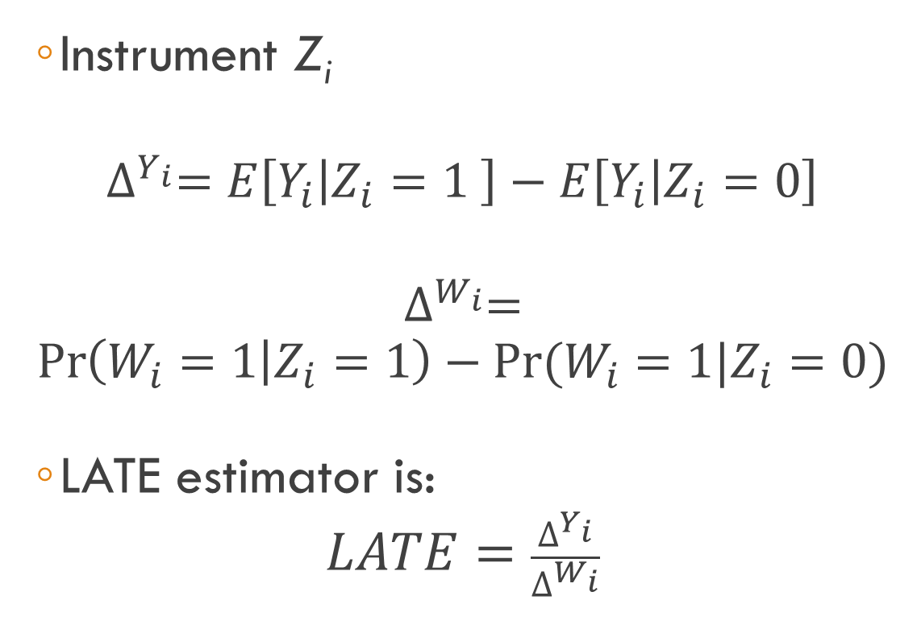
Instrumental Variables: Binary Instrument
  Instrument Z_{i}
$$∆^{Y_{i}}=E\left[Y_{i} | Z_{i}=1 \right]−E\left[Y_{i} | Z_{i}=0\right]$$
$$∆^{W_{i}}=$$
$$\operatorname{Pr}\left(W_{i}=1 | Z_{i}=1\right)−Pr⁡(W_{i}=1|Z_{i}=0)$$
  LATE estimator is:
$$LATE=\frac{∆^{Y_{i}}}{∆^{W_{i}}}$$
“Compliers”:
  Those who were shifted into treatment group as a result of having high versus low value of instrument
LATE is the average treatment effect for compliers
  Not equal to overall average; that is not identified
  See Imbens and Angrist (‘94); Angrist, Imbens, and Rubin (‘96)

Slide 47
User Model of Clicks:
Results from Historical Experiments
OLS Regression:
  Features: advertiser effects and position effects
IV Regression
  Project position indicators on A/B testid’s.
  Regress clicks on predicted position indicators.
Estimates show smaller position impact than OLS, as expected.
Position discounts important for disentangling advertiser quality scores
Clicks as a Fraction of Top Position 1 Clicks
Search phrase: |  | iphone |  |  | viagra
Model: |  | OLS | IV |  | OLS | IV
Top Position 2 |  | 0.66 | 0.67 |  | 0.28 | 0.66
Top Position 3 |  | 0.40 | 0.55 |  | 0.14 | 0.15
Side Position 1 |  | 0.04 | 0.39 |  | 0.04 | 0.13

Slide 48
Role for Supervised ML in IV
First-stage estimation (project treatment on instrument) is a prediction problem
Heterogeneous IV
See Belloni, Chernozhukov and Hansen on Instrumental Variables with LASSO

Slide 49
Conclusions
Other active areas
  Causal inference in networks (Ugander, Karrer, Backstrom, and Kleinberg, 2013; Athey, Eckles, Imbens 2015)
  Using short-term outcomes to evaluate treatment effects on long-term outcomes (Athey, Chetty, Imbens, Kang 2016)
  Robustness of causal estimates (Athey and Imbens, 2015)
  Other popular empirical approaches to causal inference: Difference in differences; synthetic control groups; regression discontinuity; simultaneous eqns
Causal inference presents new applications and challenges for ML
Social sciences and other fields that use causal inference will transform through the adoption of ML techniques over the next few years
These fields have decades of experience with nuances of causal inference in real-world, high-stakes empirical settings
  ML can learn a lot as well!

